Slide 1
Cyber Threat Analysis

Slide 2
Outline
Understand Cyber Threat Landscape
Learn to build Automated Malware Analysis Infrastructure
Create a Threat Report
Cluster the test samples into Families based on results.

Slide 3
Are we protected?
What is Cyber-threat?
Exponential increase of Cyber threats over the last decade, why?
Cyber Security
Security Concerns of the Organisations.
"There are two types of companies: those that have been hacked, and those that don't know they have been hacked.“ by Cisco CEO John Chambers.
Notes:
The possibility of a malicious attempt to damage or disrupt a computer network or system.
Sophisticated tools to ease the attack, communities, shared resources.
cybersecurity is the protection of computer systems from theft or damage to their hardware, software or electronic data, as well as from disruption or misdirection of the services they provide.
Network Security devices in place, are they sufficient?

Slide 4
Ten years of Security
Based on Trustwave Global Security Report,
Data Compromise
Web Attacks
Email Threats
Vulnerabilities
Exploit Kits
Notes:
– increased in last decade.
-Uses traditional attacking methods.

Slide 5
Data Compromise
Data breach
Impact is on Small, Medium and Largescale Enterprises
Threat can be from internal or external environment
Attackers prefer targeting IT Services provider
Human factor is the highest weakness.
Compromised data is even available for sale.
Notes:
data breach is the intentional or unintentional release of secure or private/confidential information to an untrusted environment.
Attackers prefer targeting companies that provide IT services – opens door for many business data.
Those working inside an organization R major cause of data breaches. external threat category includes hackers, cybercriminal organizations and state-sponsored actors.
Human errors, Phishing, social engineering
But this data has to be recent one – payment card is not useful after expiry.

Slide 6
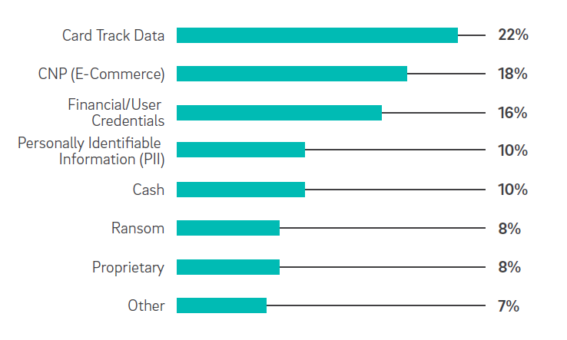
Targeted Data
Notes:
Pg:30 – 40% of breaches targeted payment card data. In 2017, It took 0-83 days for many organisations to detect a breach.
Cash – ATM fraudulent

Slide 7
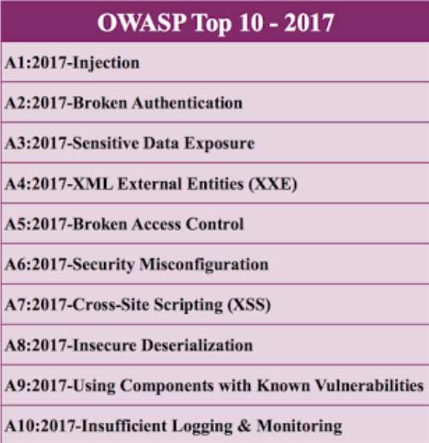
Web Attacks
Causes
Vulnerabilities
Lack of hardening
Delay or avoid upgrading
Zero – day vulnerabilities
Modifying Default configurations
Lack of Security Awareness
Notes:
signs of significant preplanning by attackers who carefully identify weak packages and tools on
targeted servers before making a move. At the same time, the basic attack techniques attackers use
tend to be the same ones they’ve been relying on for years, including cross-site scripting (XSS), SQL
injection (SQLi) and so on.
Pg 54
installations aren’t updated quickly, and many are out of date by a year or more. Some administrators delay or avoid upgrading
Default configurations: make few changes to the default configuration after installation, which gives attackers a significant advantage when looking for weak points.
Lack of security awareness: Inadequate security awareness on the part of site owners, often small companies or community organizations without dedicated IT staff, often exacerbate these issues.
Shared storage: risk of cross-infection by compromised sites located on the same server.

Slide 8
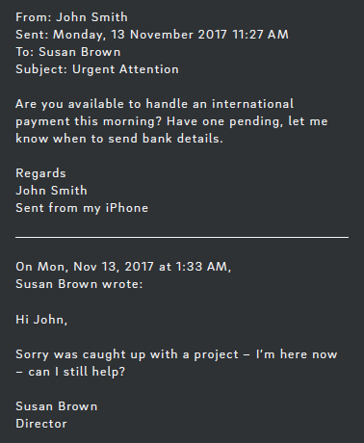
Email Threats
Strategies
Malicious attachments
Links to malicious web pages
Enticements to perform transactions
Spam or Junk eMail, notably Necurs botnet
CEO Fraud Conversation
Notes:
Malicious email authors are clever and relentless, and they are constantly developing new, or at least different ways to deceive and attack us. Although the malicious payloads found in email-based attacks frequently change, the vast majority of cybercriminals use three basic strategies:
An e-mail system- mail clients and mail servers.
https://www.lastline.com/blog/top-10-malicious-email-threats/
Malicious attachments: Emails often include dangerous attachments that install keyloggers, ransomware, and other malware when opened by the victim. Data Breach Investigations Report, hackers delivered two-thirds of all successful malware (penetrated the victim’s network) during 2016 via malicious email attachments.
Links to malicious web pages: Contained in either an attachment or in the body of the email, links to dangerous web pages also account for a significant number of data breaches.almost a quarter of users will click a malicious link if they believe the email is from a friend.
Enticements to perform transactions: Cybercriminals are increasingly researching and using social engineering to entice their victims to transmit sensitive data or perform a financial transaction. This technique does not require an attachment or any links in the message.
According to Trustwave Global Security Survey Attackers deliver more than 90 percent of spam-borne malware inside archive files as attachments labelled as business files .
Necurs, a prolific botnet that typically operates in short bursts of intense spamming
activity followed by periods of dormancy. At its peak, the botnet sends spam from between 200,000 and 400,000 unique IP
addresses daily. Increased in 2017.
CEO fraud” (or “CEO wire transfer fraud”) is a technique that attackers
use to steal money from companies

Slide 9
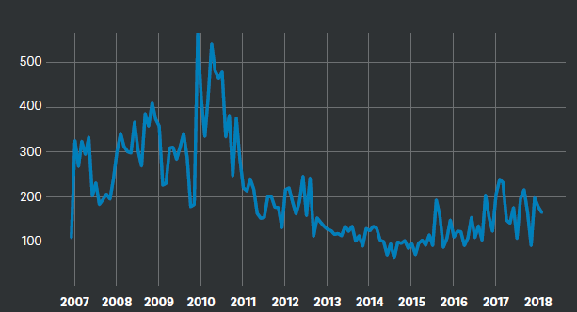
Exploits
Zero day Exploits
Do-it-yourself culture
Targeted or narrow attacks
Preventing or delaying widespread awareness
Widespread WannaCry and Petya ransomware attacks
Notes:
“An exploit is a piece of software, a chunk of data, or a sequence of commands that takes advantage of a bug or vulnerability to cause unintended or unanticipated behaviour to occur on computer software, hardware, or something electronic (usually computerized). Such behaviour frequently includes things like gaining control of a computer system, allowing privilege escalation, or a denial-of-service (DoS or related DDoS) attack [7].”
Targeted attack groups that purchase these exploits are likely to use them sparingly, in extremely limited attacks, thereby preventing or delaying the widespread awareness of such exploits.
Shadow Brokers hacking group enabled the widespread WannaCry and Petya ransomware attacks

Slide 10
Cryptocurrency and Crime
Digital money for financial transactions.
Properties – Anonymity, Highly Secure, Irreversible, Instantaneous
A choice of payment method in ransomware attacks.
Cryptojacking - exploiting the power of victims' computers to mine crypto-currency.
Many sites started running Monero mining software in a browser instead of advertisements.
Notes:
Cryptocurrencies are forms of digital money used to buy and sell anonymously on the internet and in other environments in which physical currency exchange is impossible or impractical. The most common obfuscation
techniques were packing and crypting, not detected in signature based techniques.
Through phishing emails attackers share a compromised link and convince the victims to click the link which directs users to a website domain that allows hackers to run a short script designed to begin the mining. Hackers make use of botnets, a network of infected computers which can be controlled by hacker to log the transactions to distribution ledger.

Slide 11
Malware
Security Tools are advancing, so is Malware
Malware often use obfuscation techniques to avoid detection
Malware executes even after reboots.
Opens back door for an attacker
Remote Access Trojan and bots are frequently used to transfer data.
Viruses, Screen-locking ransomware, Trojan horses, Rootkits, Backdoors
Notes:
any software intentionally designed to cause damage to a computer, server or computer network.
Malware is using advanced techniques such as packing and crypting., FINGERPRINTING- In computer science, a fingerprinting algorithm is a procedure that maps an arbitrarily large data item (such as a computer file) to a much shorter bit string, its fingerprint, that uniquely identifies the original data for all practical purposes. A packer is a utility that bundles program files and resources into a single archive file. Packing algorithms are designed to avoid anti-malware systems
every time the computer reboots by manipulating the registry entries or by creating services which starts the Malware execution automatically.
The Autorun key contains a PowerShell script that loads script in another key. The second script injects a small shellcode that decompresses and executes the malware and DLL in the memory of the third key which opens a backdoor for an attacker. Attacker can use this backdoor to download and execute arbitrary programs.
After stealing the data, attackers need to implement exfiltration techniques on the malware samples to utilise the data. But, exfiltration can create a trail which may identify the malware’s source. So, attacker has to connect to another remote computer to exfiltrate the data or they should use another malware component to handle the exfiltration. The attackers have to maintain connections to transfer the exfiltrated data and this is mostly done by using the raw TCP socket connections to communicate between the victim and the attacker. Remote Access Trojan and bots are frequently used to transfer data.
a piece of code which is capable of copying itself and typically has a detrimental effect, such as corrupting the system or destroying data.
is any malicious computer program which misleads users of its true intent.
Rootkit - , designed to enable access to a computer or areas of its software that is not otherwise allowed
A backdoor is a method, often secret, of bypassing normal authentication or encryption

Slide 12
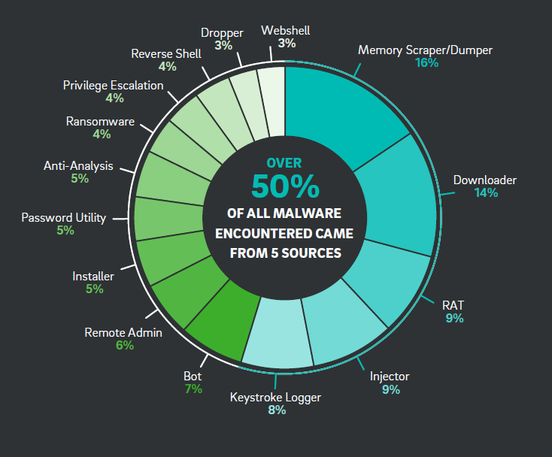
Types of Malware Encountered in 2017

Slide 13
Contributing Factors
Cybercriminals - skilled professionals with sufficient resources, time and patience.
Ease of use of exploit kits.
Individual attackers or Cooperative attack groups.
Stolen data can be bought or sold.
Difficulty in tracing back to the attackers.
Notes:
Criminals could acquire most of
the PII categories we examined for less than USD $1 per record, due to
the sheer volume of data available for purchase and the varying quality
of the offerings. For example, a large collection of payment card data
may be next to useless if the records are not recent.

Slide 14
Why Automated Malware Analysis?
Malware analysis is the study or process of determining the functionality, origin and potential impact of a given malware sample. Automation reduces the amount of time required to analyze.
Use Cases
Computer security incident management
Malware research
Indicator of compromise (IOC) extraction
Notes:
Malware analysis involves a complex process to identify malware behaviour, what they do, what they want and what their main objectives are.
Malware infection on your system can cause damage to your system such as file deletion, change in registry, file modification, stealing confidential data/information, and so on.
Automation will allow analysts to focus more on the tasks that need more attention in human analysis
Computer security incident management: If an organization believes that malware may have entered into its system, a response team will react to the situation. Next, they will want to perform malware analysis on any potentially malicious files that are discovered. This will then determine if it is indeed malware, what type, and the impact that it might have on the respective organizations’ systems.
Malware research: Academic or industry forum where malware researchers perform malware analysis. This creates the best understanding of how malware works and the newest methods used in its creation.
Indicator of compromise (IOC) extraction: Sellers of software solutions and products may conduct bulk malware analysis in order to determine potential new indicators of compromise which will in turn help the organizations to defend themselves against malware attacks.

Slide 15
Methodologies of Analysis
Static Analysis: is a process of software debugging without executing the code or program.
Modern malware is authored using evasive techniques to defeat this type of analysis.
Dynamic Analysis: performs an execution of the malware itself and observes the malware activity.
Can observe the changes that occur when the malware is being executed.
Notes:
Static - Earlier stage .
a method of computer program debugging that is done by examining the code without executing the program.
You have to do disassembling and decompiling first, and after successfully performing reverse engineering you can analyze the low-level assembly
code. , for example by embedding syntactic code errors that will confuse disassemblers but that will still function during actual execution.

Slide 16
Where can we analyse?
In computer security, a sandbox is a security mechanism for separating running programs, usually in an effort to mitigate system failures or software vulnerabilities from spreading.
Execute untested or untrusted programs or code
Tightly controlled set of resources
Virtual machines emulate a complete host computer
No risk
Notes:
When performing malware analysis, you need a safe environment and the network should not connect to production networks.
To isolate the execution of program to reduce the spreading.
No risk harm to the host machine or operating system
Emulate = behave like host machine here . The guest operating system runs sandboxed in the sense that it does not function natively on the host and can only access host resources through the emulator.

Slide 17
What is Cuckoo?
Cuckoo Sandbox started as a Google Summer of Code project in 2010 within the Honeynet Project.
Open source automated malware analysis system.
Can analyze any malicious file under Windows, OS X, Linux and Android.
Integrated with ssdeep, Volatility, Yara and other Open Source Tools.
Can be Customized in any environment.
Sandbox Environment
Supports KVM, Vmware and VirtualBox.
Free Software, No Licensing.

Slide 18
What can it analyse?
Cuckoo is designed to analyse the following kinds of files:
Generic Windows executables
DLL files
PDF documents
Microsoft Office documents
URLs
PHP scripts
Almost everything else

Slide 19
What can it deliver?
Can analyze Malicious files, URLs/hashes under Windows, Linux, Mac OS X, and Android virtualized environments.
Trace API calls and support Static Analysis.
Dump and analyze network traffic, even when encrypted with SSL/TLS. Supports Routing.
Perform advanced memory analysis of the infected virtualized system through Volatility as well as on a process memory granularity using YARA.
Notes:
Cuckoo’s modular design and powerful scripting capabilities allows us to use Cuckoo as a standalone application or can be integrated in larger frameworks of distributed environment. Cuckoo can be customised to any aspect depending on the requirement to analyse, process and report the behaviours. Cuckoo can analyse any file and provide a detailed report outlining the behaviour of the file when executed inside a realistic but isolated environment. This open source sandbox can automate the analysing task of any suspicious file under Windows, MAC, Linux, and Android Operating Systems.

Slide 20
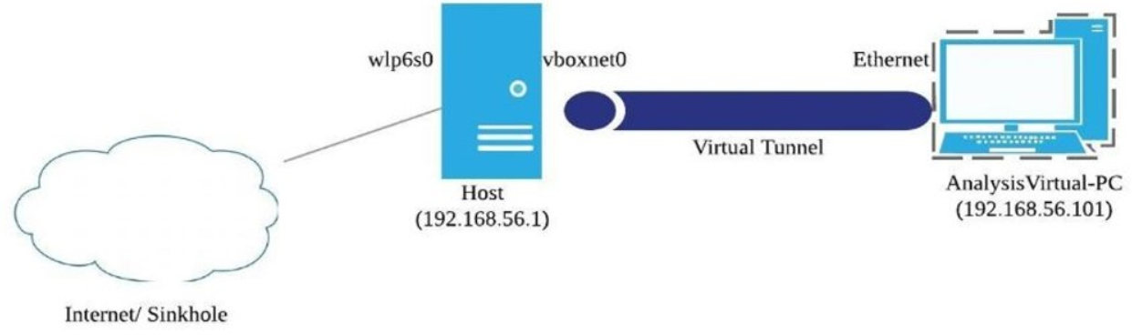
Implemented Architecture
Host
Ubuntu 16.04
4Gb RAM
VirtualBox 5.2.8 r121009
Cuckoo Sandbox 2.0.6
Guest
Windows 7 Home Basic
4 GB RAM, 64 bit OS
Agent ( Version 0.8)
Notes:
Agent The Cuckoo Sandbox consists of a central management software and isolated virtual or physical machine. Central management software handles sample execution and analysis. Each analysis is launched in a new isolated virtual or physical machine.
The main components of Cuckoo’s infrastructure are a Host machine which hosts the Central Management software and several Guest machines which are either virtual or physical machines. The host runs the core sandbox component to manage the entire analysis process, while the guests are isolated environments where the malware samples are executed and analysed safely.

Slide 21
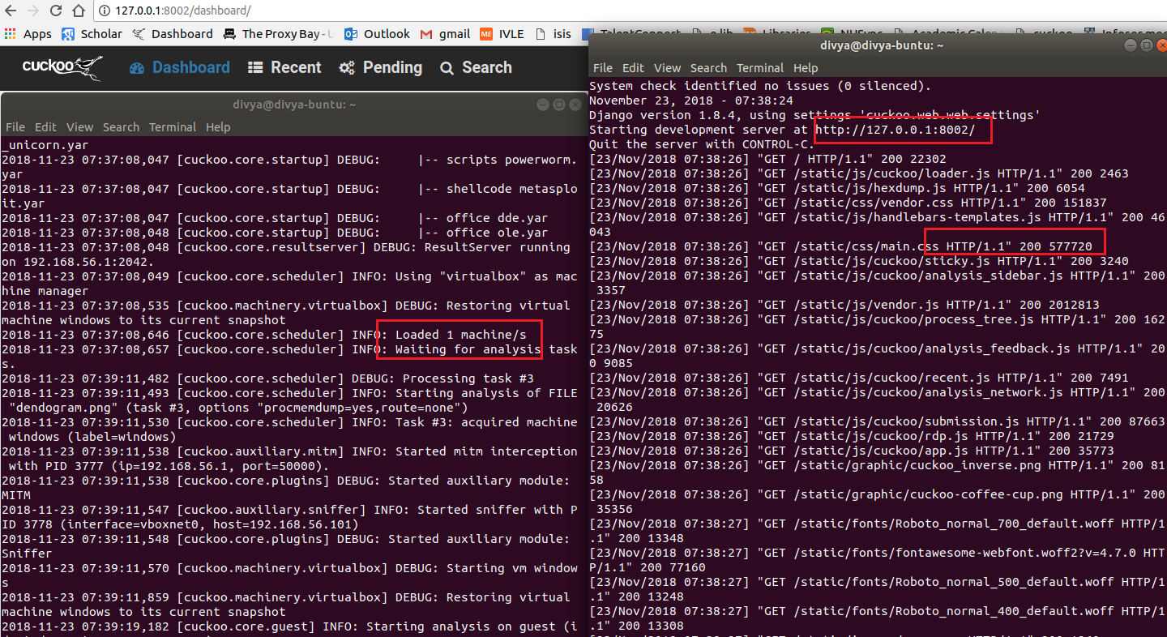
Initializing Cuckoo

Slide 22
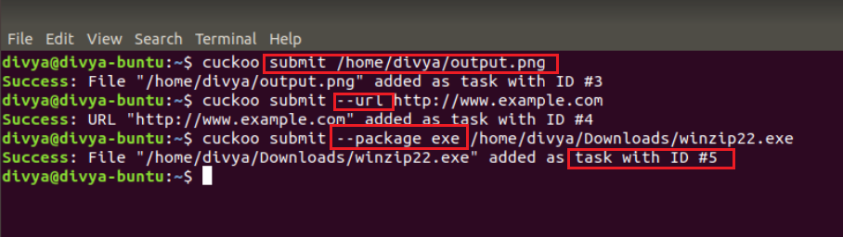
SUBMITTING MALWARE SAMPLES
Fig: CLI utility
Notes:
memory ,machine, platform

Slide 23
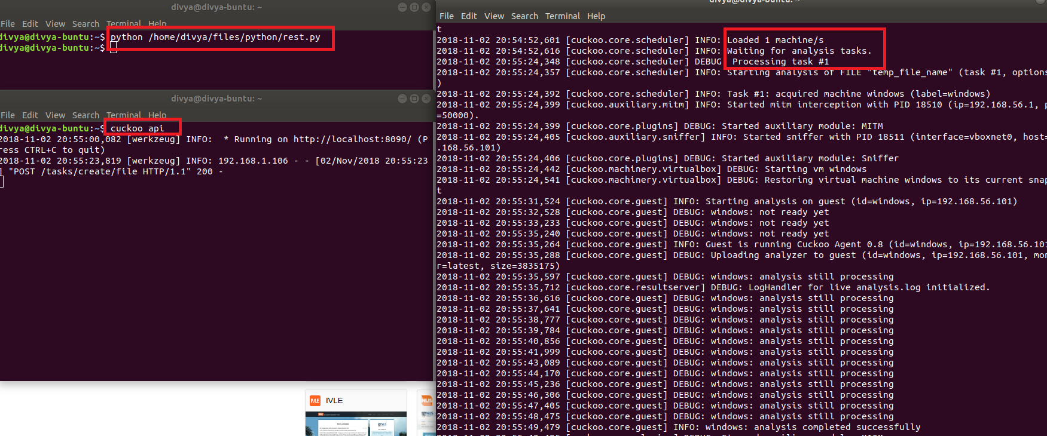
SUBMITTING MALWARE SAMPLES Contd..
Fig: REST API utility
Notes:
REST is any interface between systems using HTTP to obtain data and generate operations on those data in all possible formats,

Slide 24
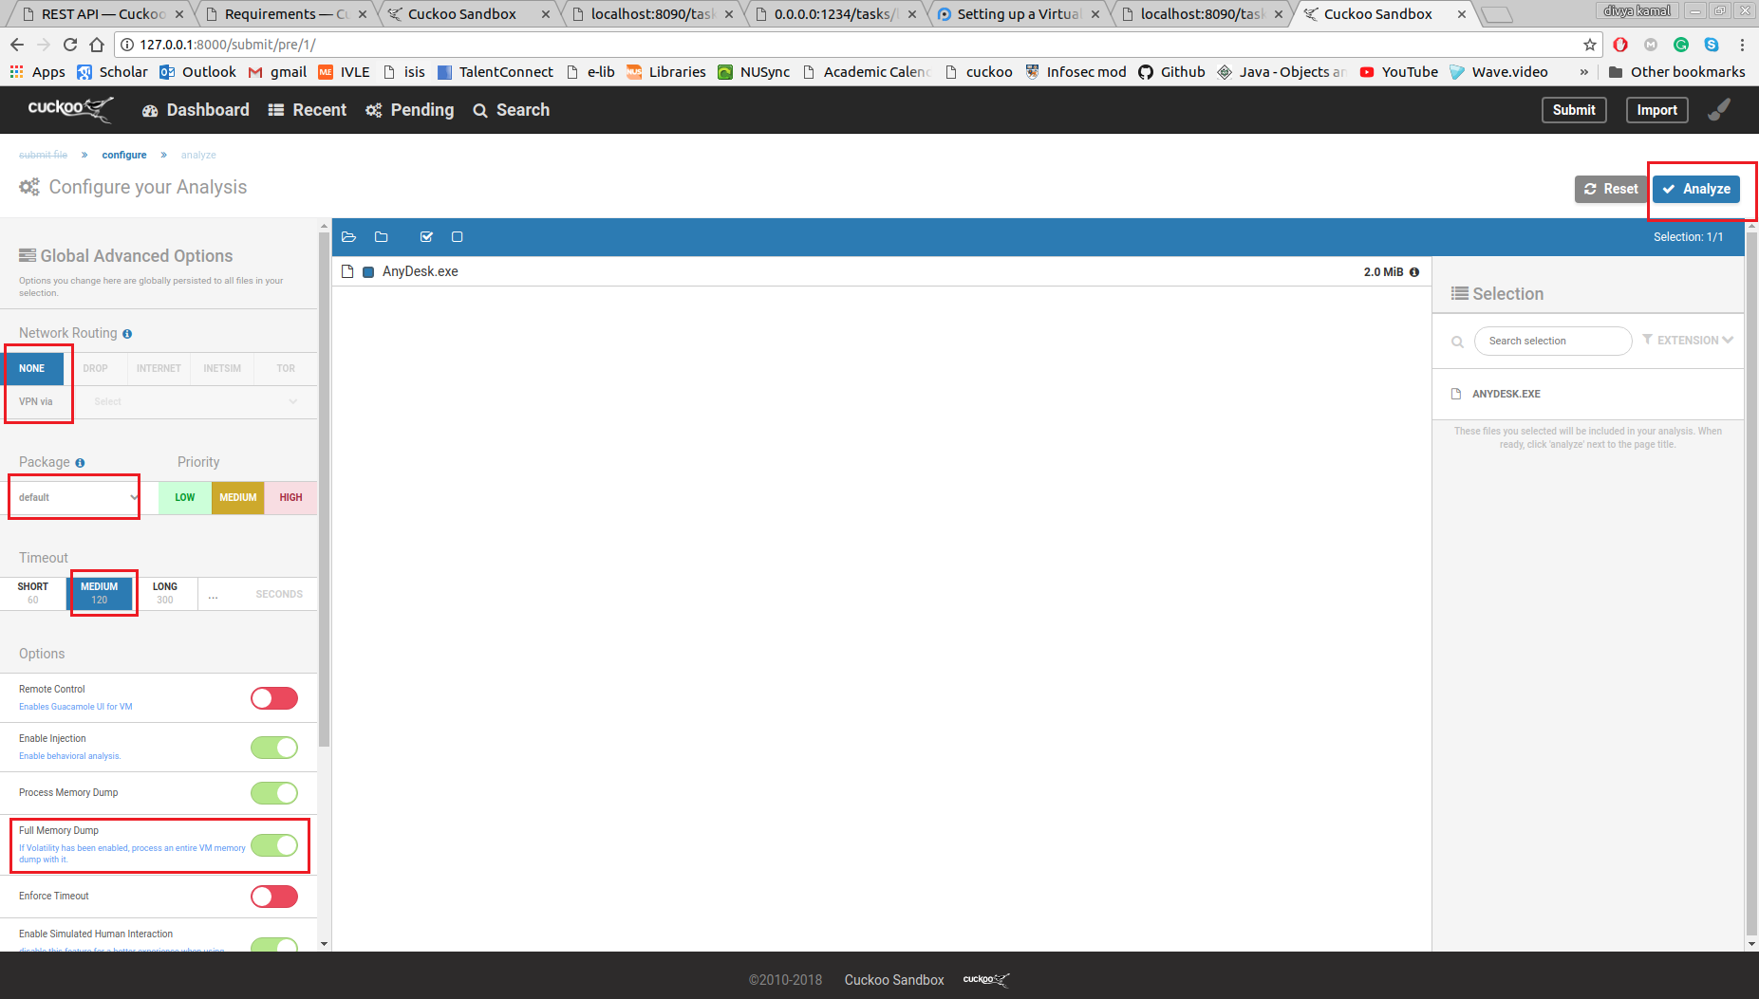
SUBMITTING MALWARE SAMPLES Contd..
Fig: Web utility

Slide 25
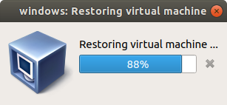
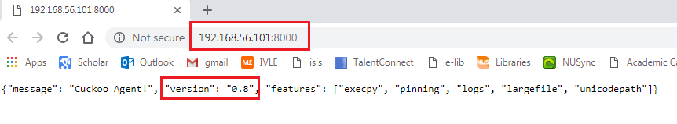
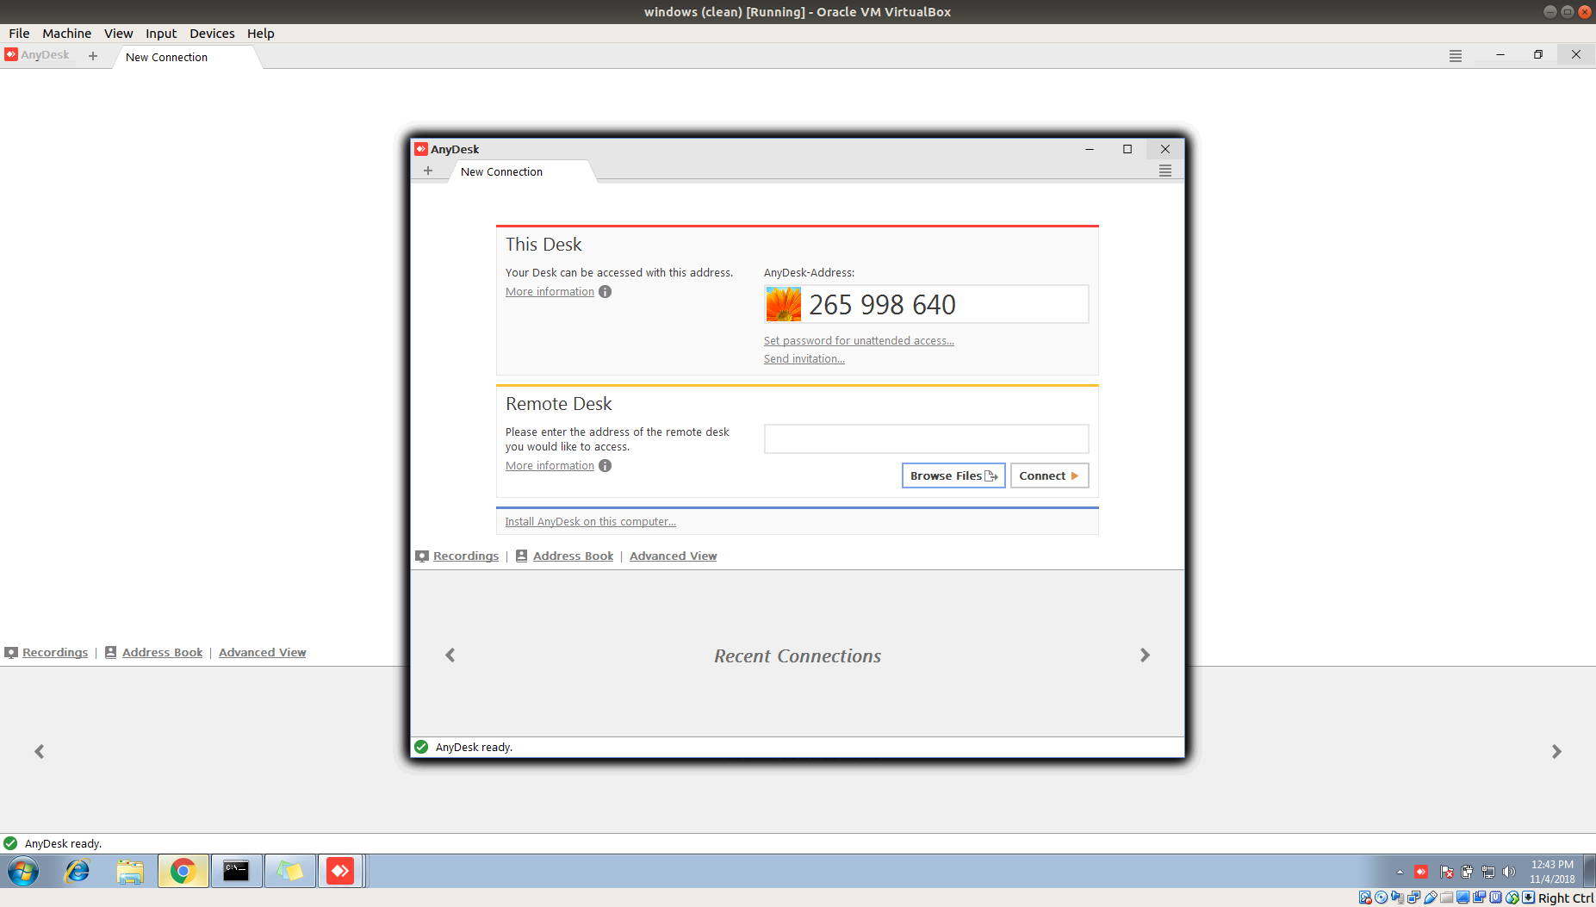
Execution of the sample
Fig: Initializing Guest OS
Fig: Initializing Agent
Fig: Execution of Sample
Notes:
Agent
Background and

Slide 26
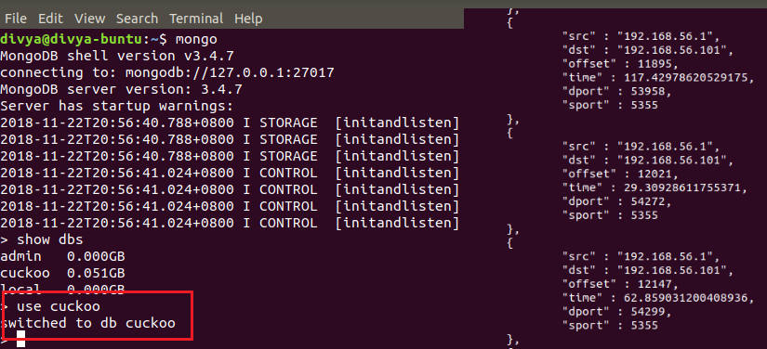
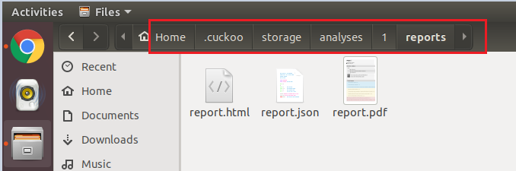
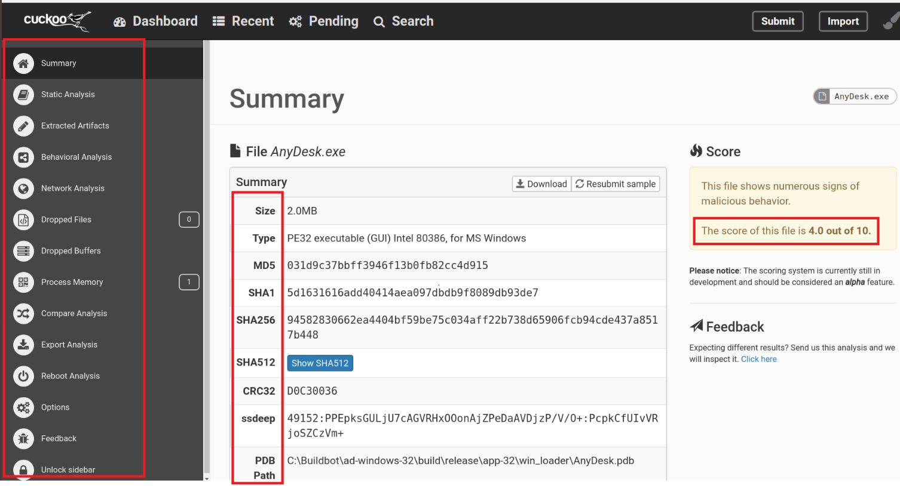
Analysis Results
Fig: Local Storage
Fig: in MongoDB
Fig: in web interface

Slide 27
Analysis Results
Fig: Analysis Results in Web Interface
Notes:
Ssdeep - ssdeep is a program for computing context triggered piecewise hashes (CTPH). Also called fuzzy hashes,
The .pdb contains information for the compiler. It contains debugging symbols. It also contains names of library's that are used in the application and also names of forms and resources.seeing .pdb path in the exe file is because it was released with debugging turned on.
CRC32 algorithm to detect changes between source and target data.

Slide 28
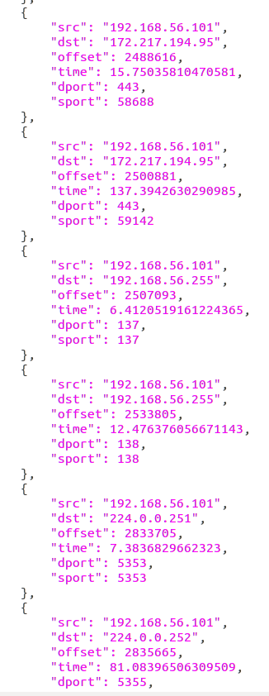

Interesting Information
Fig: extraction of interesting information

Slide 29
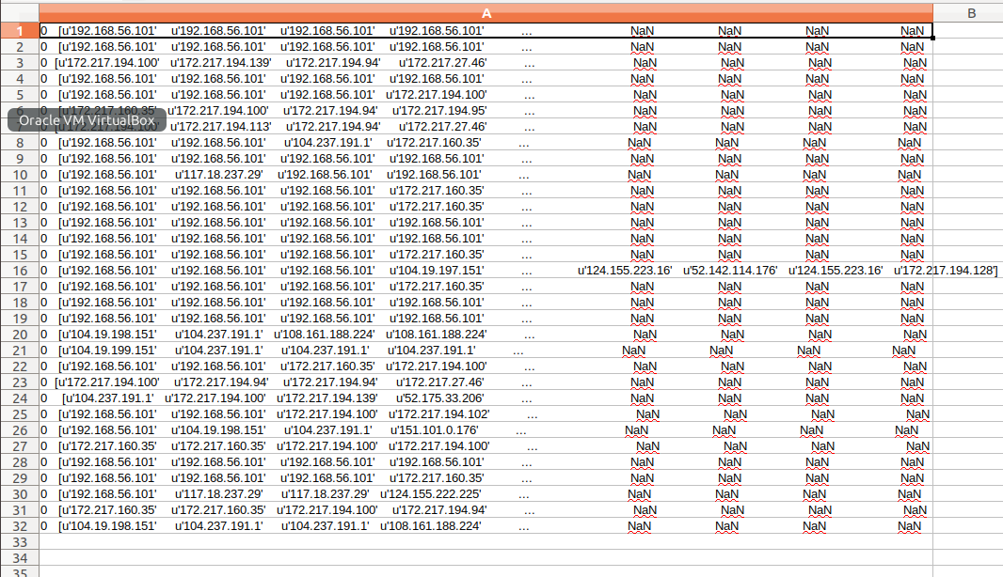
PANDAS DATA FRAME
Fig: unstructured to structured data
Notes:
Pandas is an open source. data analysis tools
Pandas DataFrame is a 2-D data structure with columns of potentially heterogeneous tabular data structure with labeled axes

Slide 30
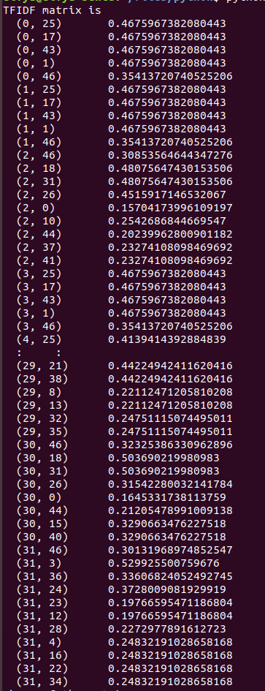
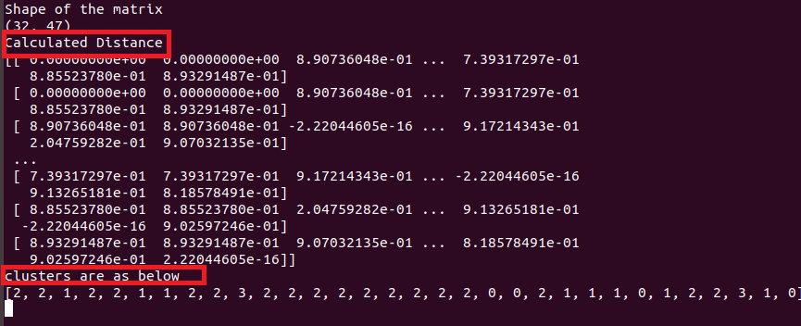
TFIDF MATRIX
Notes:
In information retrieval, tf–idf or TFIDF, short for term frequency–inverse document frequency, is a numerical statistic that is intended to reflect how important a word is to a document in a collection or corpus.^{[1]} It is often used as a weighting factor in searches of information retrieval, text mining, and user modeling. The tf–idf value increases proportionally to the number of times a word appears in the document and is offset by the number of documents in the corpus that contain the word, which helps to adjust for the fact that some words appear more frequently in general. Tf–idf is one of the most popular term-weighting schemes today; 83% of text-based recommender systems in digital libraries use tf–idf.^{[2]}

Slide 31
Ward Clustering Algorithm
Agglomerative Algorithm
Construct the finest partition.
Compute the distance matrix D.
DO
Find the two clusters with the closest distance.
Put those two clusters into one cluster.
Compute the distance between the new groups and obtain a reduced distance matrix D.
UNTIL all clusters are agglomerated .
Notes:
Agglomerative: This is a "bottom-up" approach: each observation starts in its own cluster, and pairs of clusters are merged as one moves up the hierarchy.

Slide 32
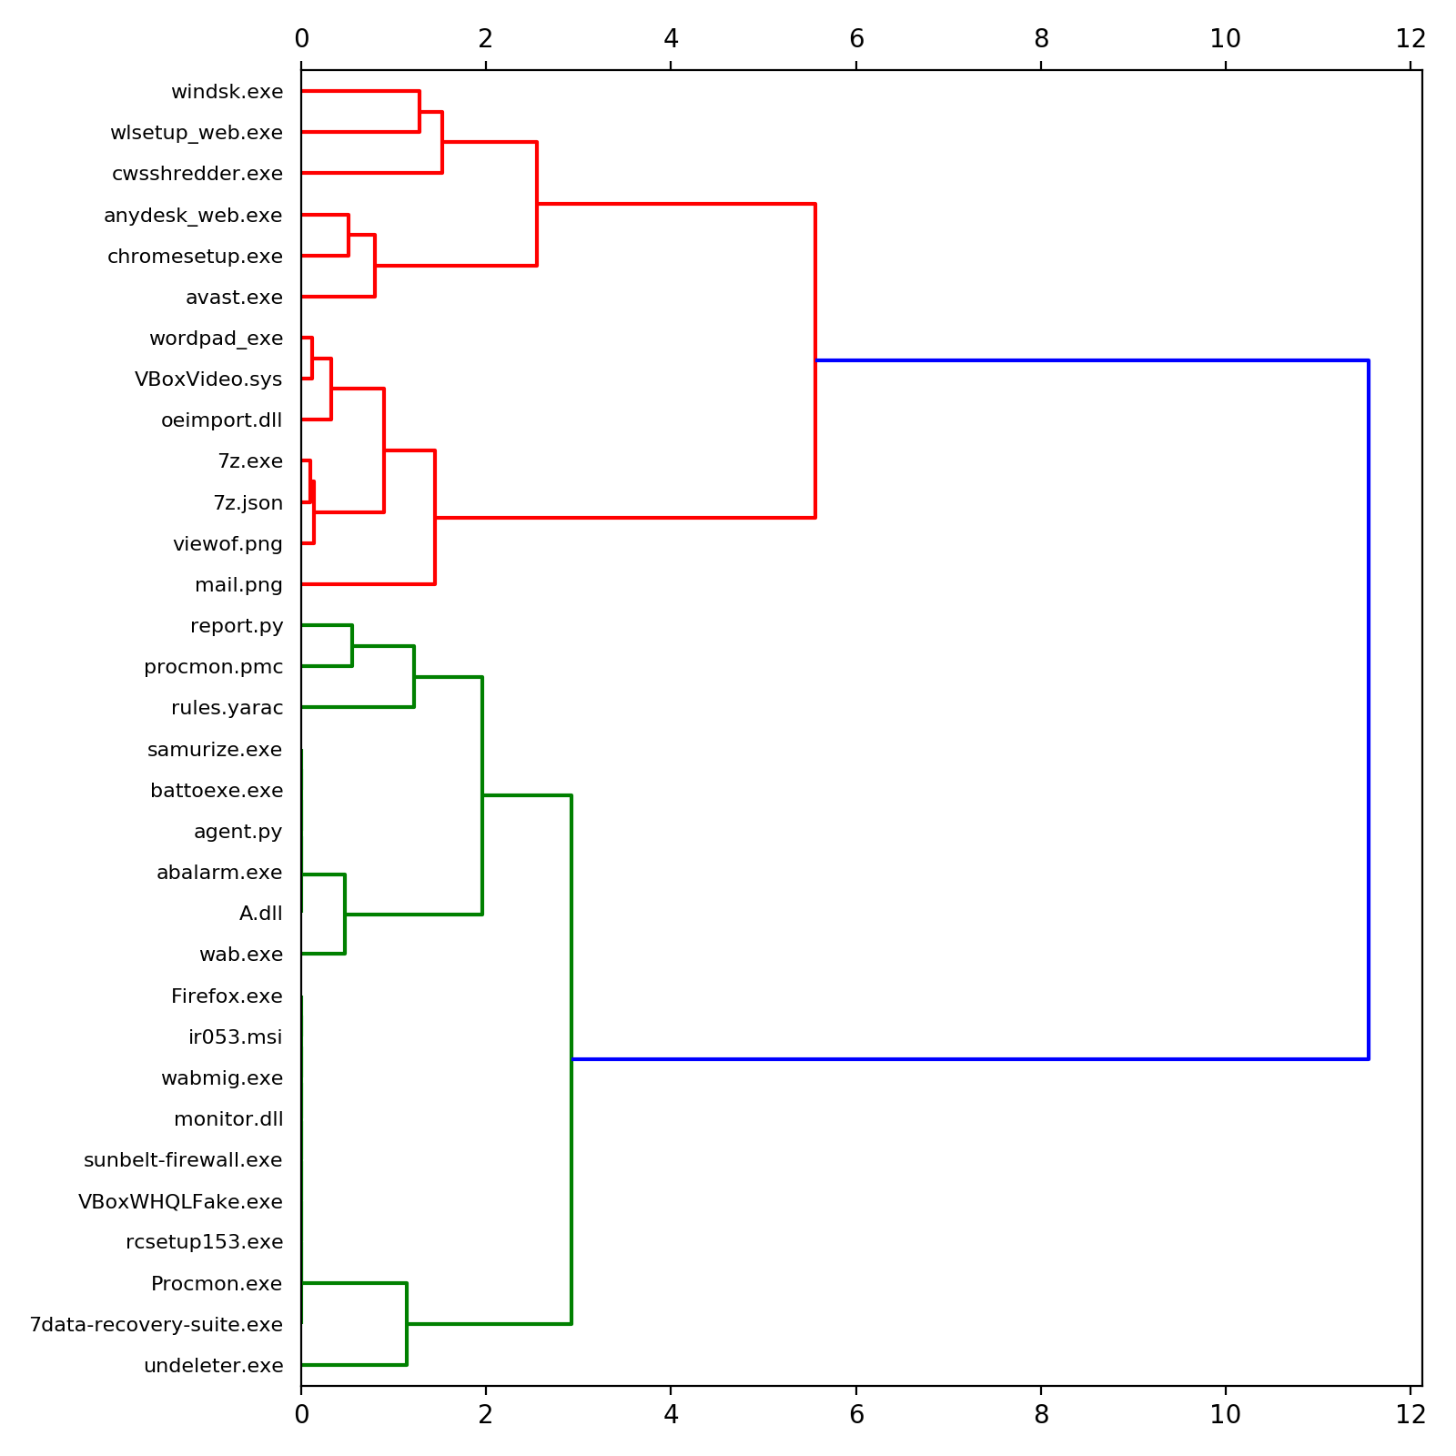

Slide 33
K- Means Clustering
A cluster is a group of data points that are grouped together due to similarities in their features
unsupervised learning algorithm
finds a fixed number (k) of clusters in a set of data
A cluster is defined by a centroid, which is a point at the center of a cluster.
Assign each data point to the closest corresponding centroid, using the standard Euclidean distance.
For each centroid, calculate the mean of the values of all the points belonging to it. The mean value becomes the new value of the centroid.
Notes:
Supervised algorithms are trained with data that provides input vectors as well as their corresponding target vectors, or the output that is expected after the data is processed.
Unsupervised models, on the other hand, are trained using data that consists only of input vectors, with no specific target output in mind. Instead of telling an unsupervised algorithm what it should be looking for in the data, the algorithm does the work itself, in a sense independently finding structure within the data.
Centroid -(either imaginary or real)
Every point in a data set is part of the cluster whose centroid is most closely located. To put it simply, K-Means finds k number of centroids, and then assigns all data points to the closest cluster, with the aim of keeping the centroids small.
K-Means starts by randomly defining k centroids. From there, it works in iterative (repetitive) steps to perform two tasks:
Assign each data point to the closest corresponding centroid, using the standard Euclidean distance. In layman’s terms: the straight-line distance between the data point and the centroid.
For each centroid, calculate the mean of the values of all the points belonging to it. The mean value becomes the new value of the centroid.
This process is repeated over and over until there is no change in the centroid values, meaning that they have been accurately grouped. Or, the process can be stopped when a previously determined maximum number of steps has been met.
Advantages of K-Means:
Widely used method for cluster analysis
Easy to understand
Trains quickly
Disadvantages of K-Means:
Euclidean distance is not ideal in many applications
Performance is (generally) not competitive with the best clustering methods
Small variations in the data can result in a completely different clusters (high variance)
Clusters are assumed to have a spherical shape and be evenly sized

Slide 34
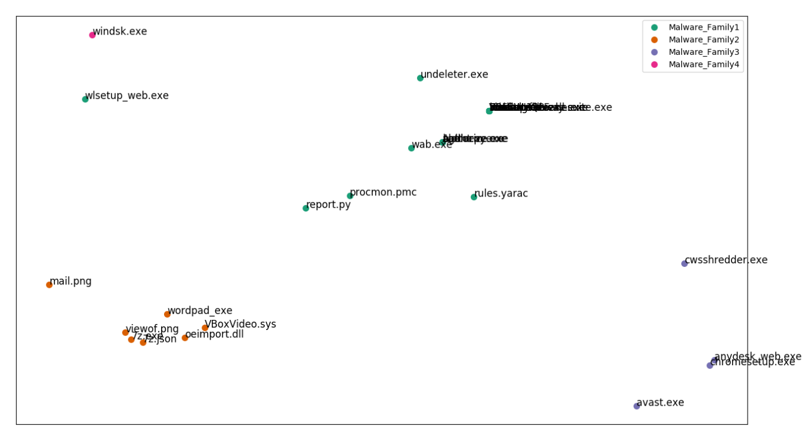
Plotting into 2-D

Slide 35

By Maddi Kamal Divya

